Slide 1

AWS Web Application Firewall
Protecting Web Applications from Online Threats
Cloud Security Expert
Enterprise Security Architecture | AWS Certified

Slide 2
PRESENTATION AGENDA
Intro to Web Security: Fundamentals
Rule Types: IP, Geo, Rate-based
AWS WAF Overview: core concepts
Monitoring: Metrics & Logging
Architecture: Global infrastructure
Best Practices: Implementation tips
Core Components: Web ACLs & Rules
Use Cases: Real-world scenarios

Slide 3

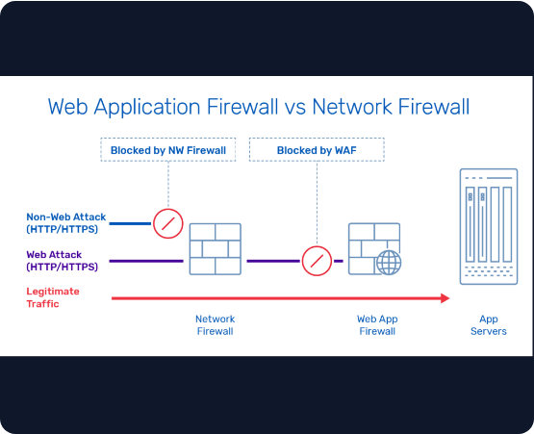
WHAT IS A WAF?
A Web Application Firewall (WAF) sits between web applications and the internet, monitoring and filtering HTTP traffic to block malicious requests.
Inspects Layer 7 traffic (Application)
Filters specific HTTP/HTTPS requests
Complements Network Firewalls

Slide 4


THE NEED FOR WEB SECURITY
Escalating Threat Landscape
API and App Protection
Modern applications are primary targets for automated bots and sophisticated cyber-attacks. Standard perimeter security is no longer sufficient to protect sensitive customer data.
As businesses shift to microservices, APIs become exposed. AWS WAF provides critical visibility and control to prevent unauthorized access and data exfiltration.

Slide 5






COMMON WEB APPLICATION ATTACKS
SQL Injection
XSS Attacks
Bot Attacks
Injecting malicious SQL queries to manipulate backend databases and steal data.
Executing malicious scripts in a user's browser to hijack sessions or deface sites.
Automated scripts performing credential stuffing, scraping, or brute-force.

Slide 6
AWS WAF Overview
Managed, Scalable Application Security

Slide 7



BENEFITS OF AWS WAF
Easy Integration
Fully Scalable
Cost Effective
Native integration with CloudFront, ALB, API Gateway, and AppSync.
Auto-scales based on traffic volume without managing servers.
Pay-as-you-go model. Pay only for what you use with no upfront costs.

Slide 8
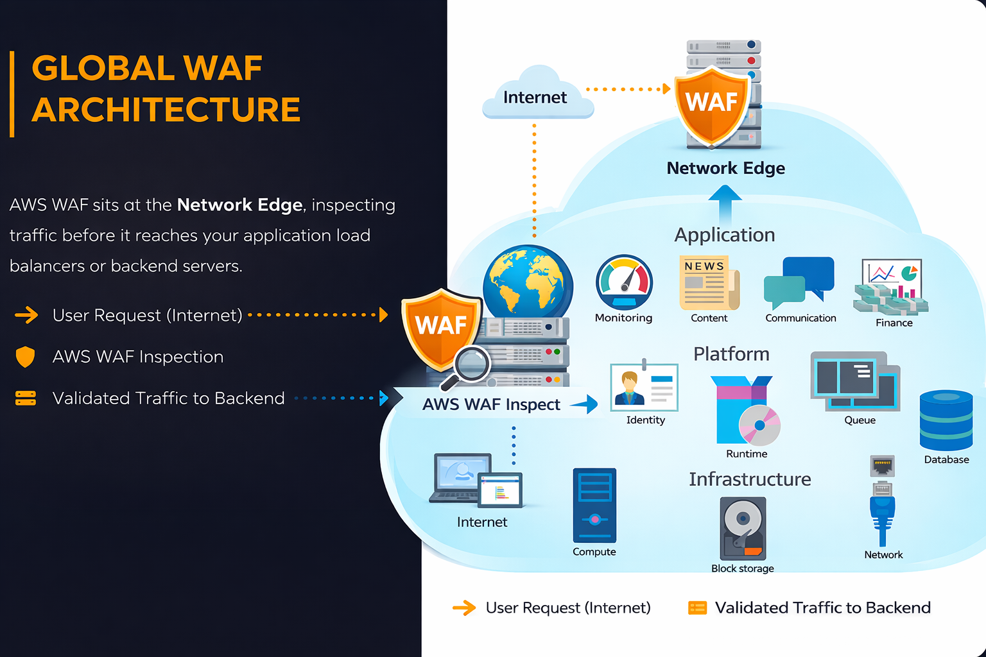

Slide 9






WAF SUPPORTED AWS SERVICES
CloudFront
App Load Balancer
API Gateway
Protecting global content delivery at edge locations.
Inspecting regional traffic within your VPC.
Securing RESTful and WebSocket APIs.

Slide 10


THE WEB ACL (ACCESS CONTROL LIST)
Main Security Container
The Web ACL is the primary resource where you define your filtering logic. It contains a set of rules that tell AWS WAF how to handle web requests.
Default Action (Allow/Block)
Rule Priority Ordering
Resource Association

Slide 11


WORKING WITH WAF RULES
Detection Conditions
Mitigation Actions
Rules define criteria such as originating IP addresses, HTTP headers, request bodies, and URI strings to identify malicious traffic patterns.
When a request matches a rule, WAF can perform actions: Allow, Block, Count (for testing), or CAPTCHA.

Slide 12






WHAT ARE RULE GROUPS?
Logical Collections
Management Styles
Consistency
A reusable collection of rules that you can apply to multiple Web ACLs simultaneously.
Can be Managed by AWS, Managed by Marketplace vendors, or Custom groups built by you.
Ensures that security policies are uniform across your entire AWS infrastructure.

Slide 13
AWS MANAGED RULE GROUPS
Core Rule Set (CRS): Protects against common vulnerabilities including OWASP Top 10.
Admin Protection: Blocks unauthorized access to administrative pages and interfaces.
Known Bad Inputs: Targets malicious request patterns frequently used by attackers.
Bot Control: Managed intelligence to detect and block malicious automated traffic.

Slide 14
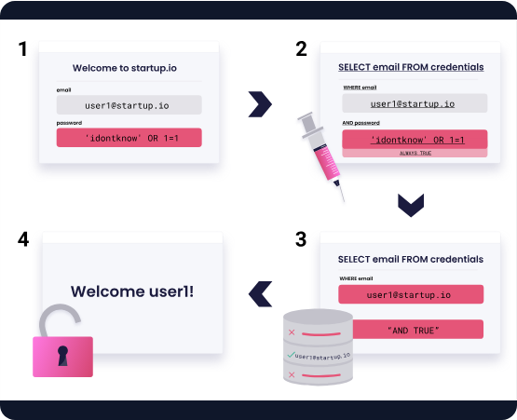
LEVERAGING CUSTOM RULES
When managed rules aren't enough, Custom Rules allow you to tailor security to your specific application needs.
Inspect specific Headers or Cookies
Regex pattern matching on URI
Blacklist known malicious IPs

Slide 15
WAF Rule Types
Specific Detection Mechanisms

Slide 16
IP MATCH RULES
10k+
Granular Source Control
Block or allow traffic based on IP address ranges (CIDR blocks). This is the fastest way to stop known attackers or restrict access to trusted internal corporate networks.
IP addresses per set

Slide 17

GEO MATCH RULES
Regional Restrictions
Filter traffic based on the country of origin. Useful for compliance or when your application is only intended for a specific geographic market.
Country-level blocking
Reducing attack surface

Slide 18


STRING & REGEX MATCH
String Match
Regex Match
Body Inspection
Looks for exact strings in headers, cookies, or query parameters (e.g., blocking "User-Agent: BadBot").
Powerful pattern matching for complex attack vectors or specific data formats within requests.
Deeply inspect the JSON or XML content within POST request bodies for malicious payloads.

Slide 19
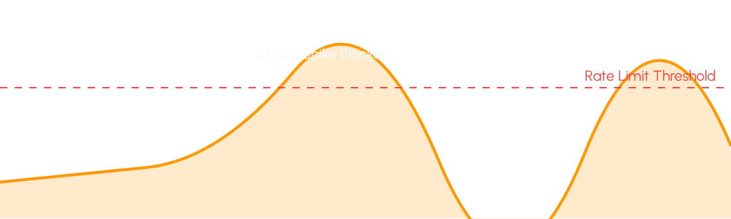
RATE-BASED RULES
DDoS Protection: Automatically blocks IP addresses that exceed a set threshold of requests within a 5-minute window.

Slide 20
SQL INJECTION PROTECTION
Prevent Database Exploits
WAF inspects requests for common SQL injection signatures like OR '1'='1' or --.
Filters Query Strings
Protects POST parameters
Blocks credential exfiltration

Slide 21

XSS MITIGATION
Defending User Sessions
WAF detects </div> tags and malicious JavaScript payloads meant to steal cookies or hijack browser sessions.
Prevents defacement
Protects Session Cookies
Secures user input forms

Slide 22
WAF Implementation
Deployment and Configuration Steps

Slide 23
AWS WAF SETUP STEPS
Create ACL
Associate
Define your primary Access Control List container.
Link your Web ACL to a resource (ALB, CloudFront).
WAF Console
Add Rules
Monitor
Navigate to the WAF service in AWS console.
Select Managed or build Custom security rules.
Analyze blocked traffic in CloudWatch logs.

Slide 24
CREATING THE WEB ACL
Resource Selection: Choose between Regional (ALB/API Gateway) or Global (CloudFront).
Default Action: Set to 'Allow' by default, then selectively block malicious traffic.
Rule Ordering: WAF processes rules from top to bottom; priority 0 is first.
Deployment: Deployment is near-instant across edge locations.

Slide 25



ADDING RULE LAYERS
AWS Managed
Custom Rules
Rate Limiting
Immediate protection against common internet threats with one click.
Rules that match your application's unique URL structure and data format.
Prevent brute-force and DDoS by limiting requests per IP.

Slide 26
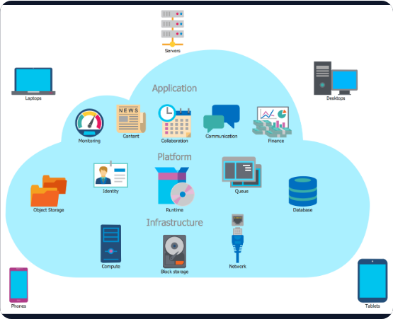
ASSOCIATING RESOURCES
A Web ACL is inactive until it is associated with a specific AWS resource.
Attach to ALB for Regional Apps
Attach to CloudFront for Global
Attach to AppSync for GraphQL

Slide 27
Monitoring and Logging
Operational Visibility

Slide 28

WAF VISIBILITY
Real-time Metrics
Integration with Amazon CloudWatch provides immediate visibility into allowed and blocked traffic patterns.
Set Alarms on Block Spikes
Analyze Rule Matches
Audit Request IDs

Slide 29


LOGGING WEB REQUESTS
S3 Destination
Kinesis Firehose
CloudWatch Logs
Store full request logs for long-term audit and compliance requirements.
Stream logs in real-time to external SIEMs or analysis tools.
Perform rapid analysis using Log Insights for incident response.

Slide 30
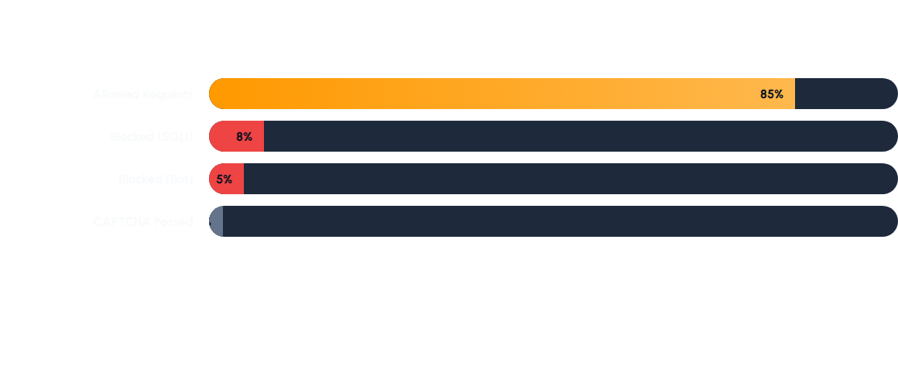
KEY WAF METRICS
Continuous monitoring helps refine rule thresholds and minimize false positives.

Slide 31
AWS Security Integrations
Building a Layered Defense

Slide 32
AWS SHIELD INTEGRATION
Unified DDoS Protection
AWS WAF works with AWS Shield to provide comprehensive Layer 3, 4, and 7 protection.
Shield Standard (Automatic)
Shield Advanced (Dedicated Team)
Automatic Layer 7 Mitigation

Slide 33
AWS FIREWALL MANAGER
Centralized Policy Management
Manage security rules across multiple AWS accounts in an organization from a single place.
Scale to 100s of accounts
Ensure compliance with policies
Auto-remediate non-compliant ACLs

Slide 34
Real World Use Cases
Practical Applications of AWS WAF

Slide 35

E-COMMERCE SECURITY
Protecting Transactional Data
E-commerce sites face high risks of SQL injection and automated price scraping.
Secure Payment Portals
Prevent Inventory Scraping
Protect Login Endpoints

Slide 36
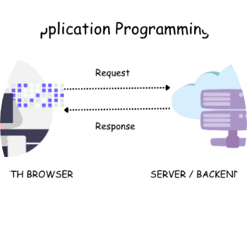
PROTECTING APIS
API Gateway Hardening
Public APIs are vulnerable to abuse. WAF helps manage request volume and detect malformed payloads.
Granular Rate Limiting
Input Validation
Key-based Filtering

Slide 37

PREVENTING BOT ATTACKS
Advanced Bot Control
Bots consume resources and skew analytics. AWS WAF provides bot labels to categorize and block scripts.
Detect Search Engine Crawlers
Block Malicious Scrapers
Stop Credential Stuffing

Slide 38
Best Practices
Optimizing Security and Cost

Slide 39
AWS WAF BEST PRACTICES
Enable Managed Rules: Start with CRS and IP Reputation.
Implement Rate Limits: Protect every public endpoint.
Monitor Logs Regularly: Audit false positives in Log Insights.
Layered Security: Use WAF with IAM, Shield, and CloudTrail.
Use 'Count' First: Test rules before blocking traffic.
Cost Control: Remove unused rules and sets.

Slide 40


Thank You!
Questions & Answers
AWS Security Solutions Portfolio
Visit aws.amazon.com/waf for more details.

Slide 41






IMAGE SOURCES
https://www.a10networks.com/wp-content/uploads/web-application-firewall-vs-network-firewall-1024x539.png
Source: www.a10networks.com
https://www.conceptdraw.com/How-To-Guide/picture/Computer-Networks-Cloud-Computing-Diagrams-Cloud-Computing.png
Source: www.conceptdraw.com
https://static.vecteezy.com/system/resources/previews/067/903/076/non_2x/security-logo-design-blue-shield-and-lock-symbol-for-safe-digital-access-and-protection-vector.jpg
Source: www.vecteezy.com
https://images.ctfassets.net/4un77bcsnjzw/5f4WTLP2LxjP8VX90lKt7I/efc24ee13738349d555ffe6c9f866c58/SQL_Injection_Attack.svg
Source: learn.snyk.io
https://static.vecteezy.com/system/resources/previews/069/816/984/large_2x/global-network-map-digital-connections-glowing-nodes-dark-background-website-banner-photo.jpg
Source: www.vecteezy.com
https://img.freepik.com/premium-vector/cyber-security-fingerprint-dark-blue-abstract-digital-conceptual-technology-background_87946-472.jpg
Source: www.freepik.com

Slide 42




IMAGE SOURCES
https://static.vecteezy.com/system/resources/previews/048/967/243/non_2x/e-commerce-checkout-page-concept-with-payment-method-in-shopping-cart-secure-payment-gateway-select-and-activate-a-suitable-mobile-payment-method-for-a-seamless-online-shopping-experience-vector.jpg
Source: www.vecteezy.com
https://miro.medium.com/1*YrVYFtEiQC6ySf1JxmUraQ.png
Source: qa-nora.medium.com
https://offensoacademy.com/wp-content/uploads/2026/01/image.png
Source: offensoacademy.com
https://miro.medium.com/1*9lwFCltCReo4MmizE4piiQ.png
Source: blog.prateekjain.dev

